Slide 1








Patient Encounter Cost and Risk Analysis in Healthcare Systems
Presented By :
Date : 12th July2025
Niharika Verma
1

Slide 2


PROJECT INTRODUCTION
Healthcare organizations today face increasing pressure to manage the rising costs and financial uncertainties linked to patient care.
This project leverages SQL-based data analysis to uncover key insights into patient encounters, focusing on identifying patients with consistently high costs, assessing the financial impact of medical procedures, and detecting risks tied to insurance coverage gaps.
By analyzing data from multiple sources—including patients, encounters, procedures, payers, and healthcare providers—this study supports strategic decision-making in resource allocation, patient management, and financial planning.
2

Slide 3

Dataset Structure
Tables-:
Encounters
Organization
Patients
Payers
Procedurest
3

Slide 4
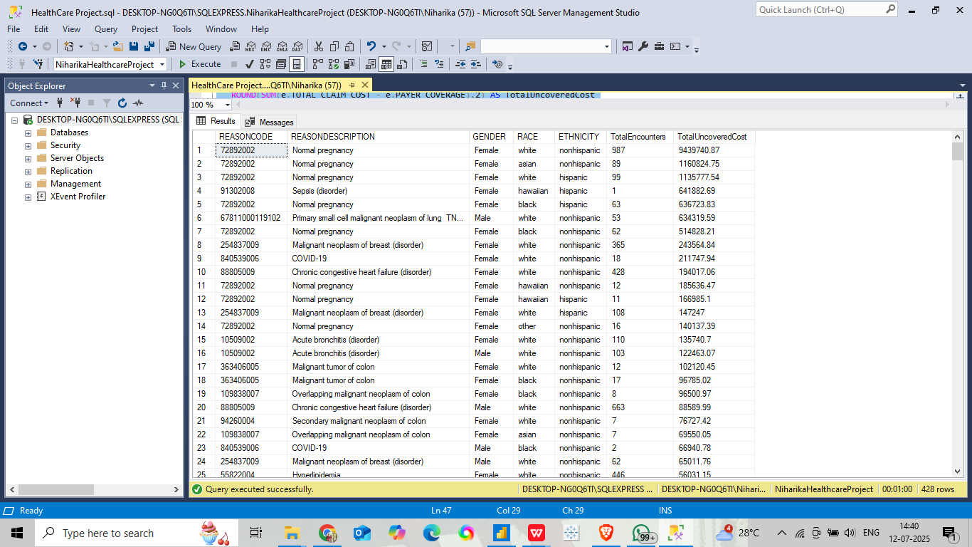
Evaluating Financial Risk by Encounter Outcome :
Objective:
Identify Reason-Codes associated with the highest uncovered costs by analyzing patient demographics and encounter outcomes to assess financial risk.
Key Insights:
Certain Reason-Codes consistently result in higher uncovered costs, especially among specific patient groups or encounter outcomes, indicating targeted financial risk areas.
4

Slide 5
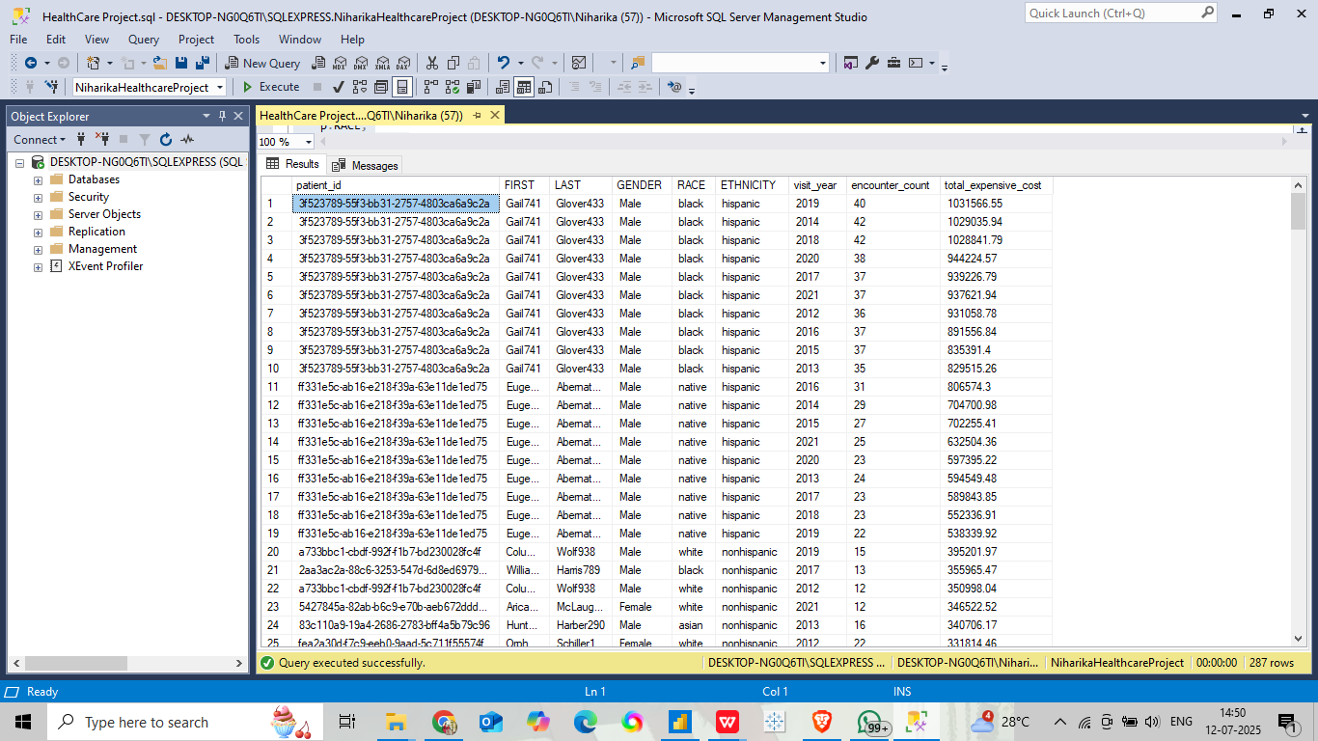
2. Identifying Patients with Frequent High-Cost Encounters :
Objective:
Identify high-utilization patients with more than 3 high-cost encounters (>$10,000) in a year, along with their total spend.
Key Insights:
Some patients had more than 3 encounters in a year, each costing over $10,000 — showing they contribute heavily to total healthcare spending and may need focused care management.
5

Slide 6
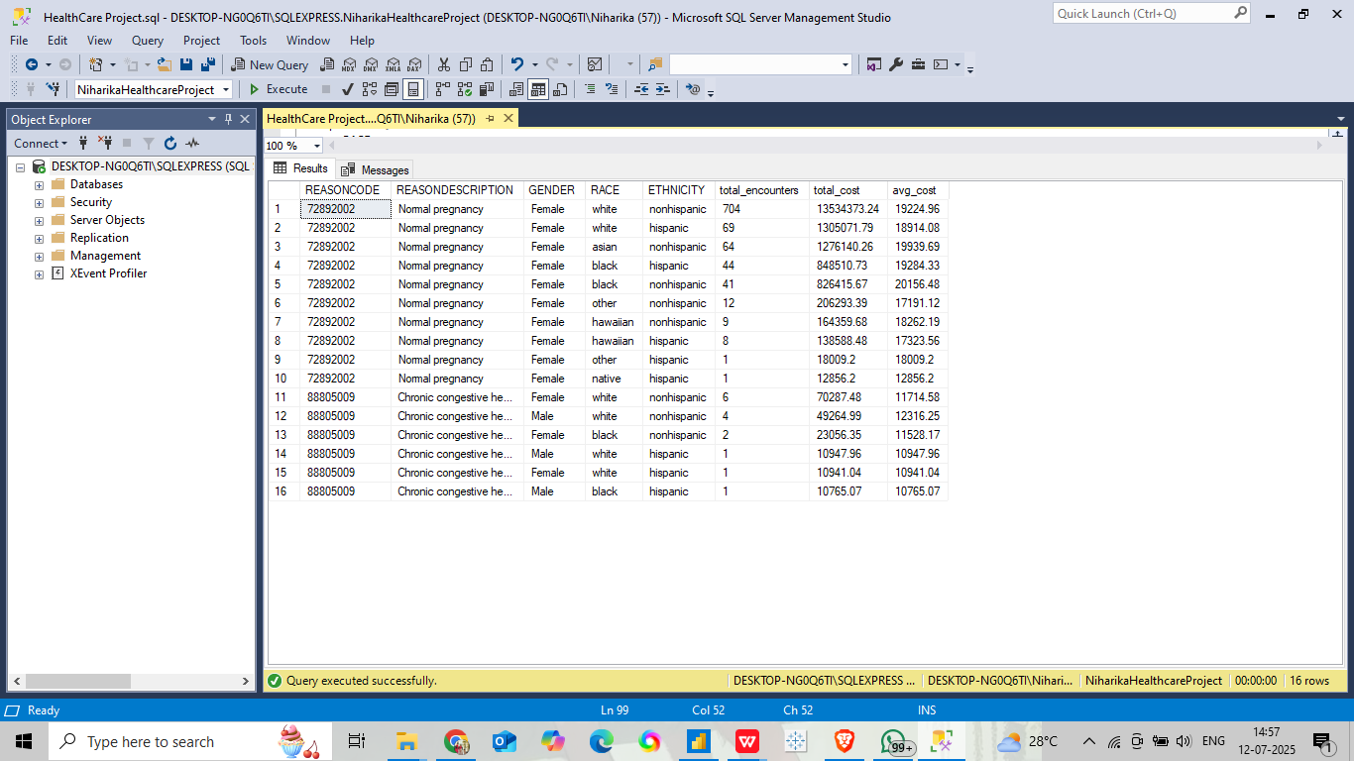
3. Identifying Risk Factors Based on Demographics and Encounter Reason :
Objective:
Identify the top 3 most frequent diagnosis codes and analyze related patient demographics to understand which groups are most impacted by high-cost encounters.
Key Insights:
High-cost encounters are most commonly linked to a few specific diagnosis codes, with certain age groups and genders being more frequently affected.
6

Slide 7
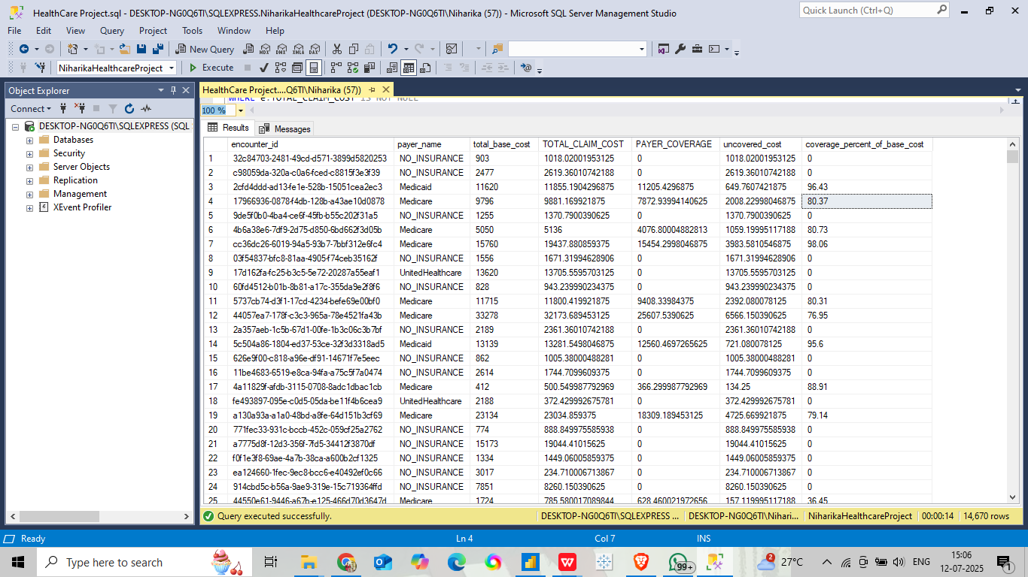
4. Assessing Payer Contributions for Different Procedure Types :
Objective:
Analyze how much payers contribute toward procedure costs and identify gaps between total claim cost and payer coverage.
Key Insights:
Some procedures have a large gap between the total claim cost and what the payer covers.
These gaps can lead to higher out-of-pocket expenses for patients, depending on the payer.
7

Slide 8
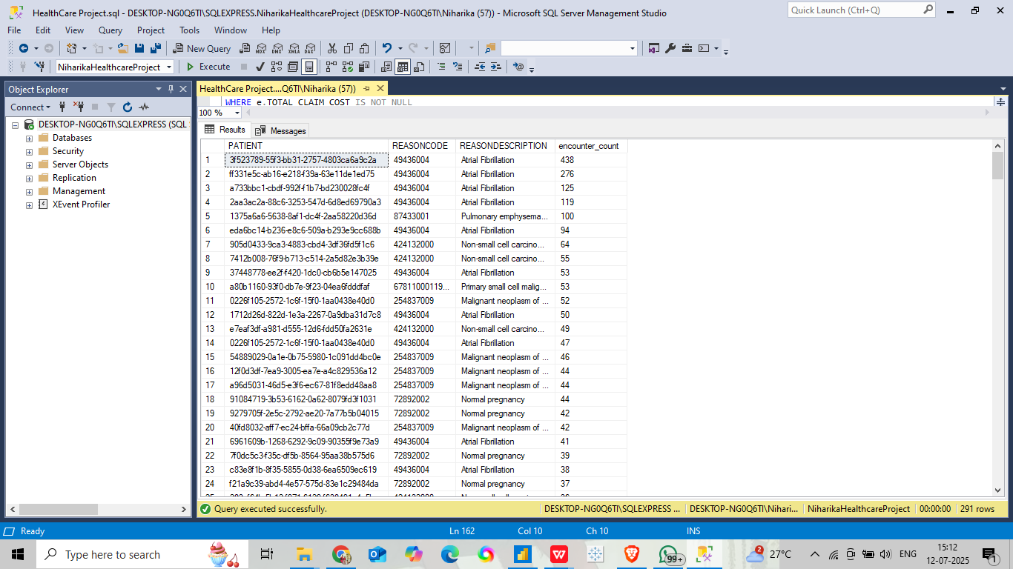
5. Identifying Patients with Multiple Procedures Across Encounters:
Objective:
Identify patients who underwent multiple procedures in separate encounters for the same diagnosis (ReasonCode).
Key Insights:
Some patients keep getting treated for the same issue in different visits, showing possible ongoing or poorly managed conditions.
8

Slide 9
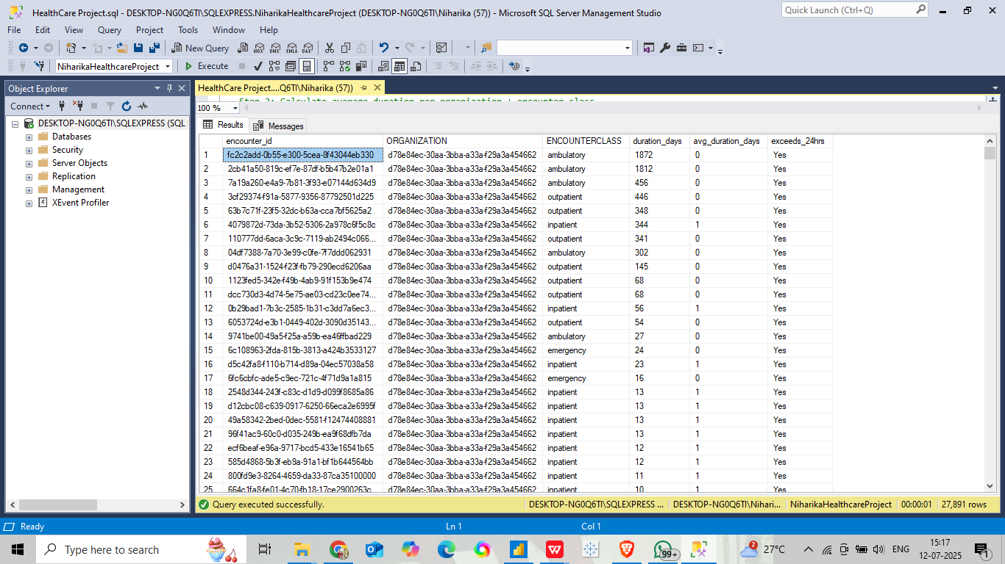
6. Analyzing Patient Encounter Duration for DifferenT Classes :
Objective:
Find the average encounter duration for each EncounterClass within each organization and spot encounters longer than 24 hours.
Key Insights:
Some EncounterClasses have longer average durations in specific organizations.
A few encounters last over 24 hours, which may point to complex cases or process delays.
9
123-456-7890

Slide 10
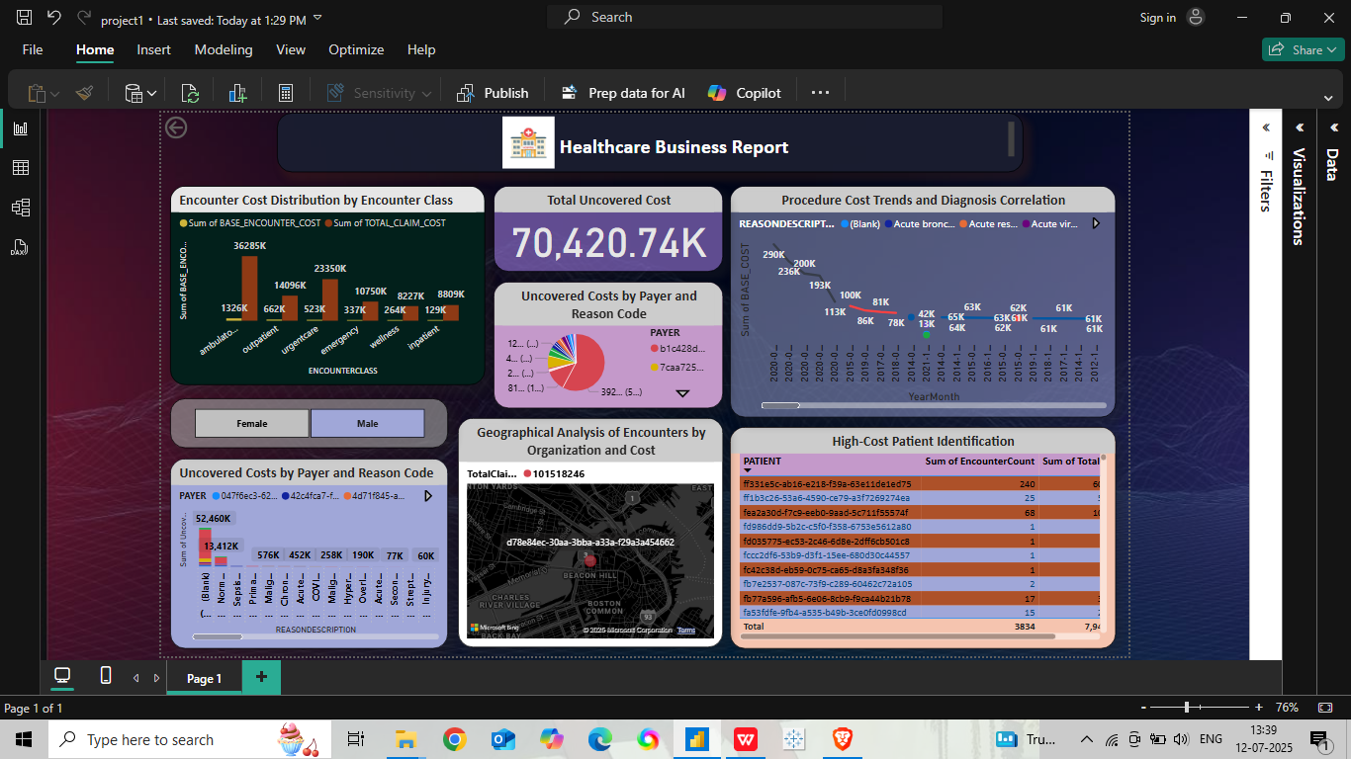
Power BI visualization :
10

Slide 11
Conclusion:
SQL QUERIES:
High-Cost Patients: A small group of patients had repeated high-cost encounters, indicating the need for targeted care management.
Financial Risk Factors: Gaps in payer coverage and repeated diagnoses reveal key areas of financial exposure.
Cost Drivers: SQL analysis showed prolonged encounters and repeated procedures are linked to high total costs.
POWER BI REPORT:
High Uncovered Costs: Over 70K uncovered cost identified, with major contributors being specific payers and rejection reasons.
High-Cost Patients: A small group of patients accounts for a significant share of total costs, indicating a need for focused care management.
Encounter Types & Costs: Emergency and inpatient encounters show the highest claim costs.
Procedure & Diagnosis Impact: Trends reveal which procedures drive cost increases over time.
Geographical Patterns: Regional hotspots of high-cost encounters help target interventions.
This report supports better planning, smarter resource use, and improved risk control in healthcare management.
11

Slide 12
Thank
you!
12

